Slide 1
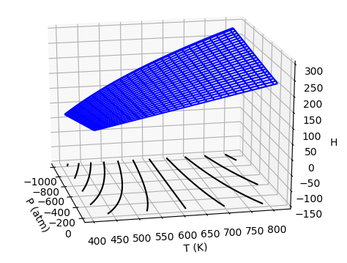

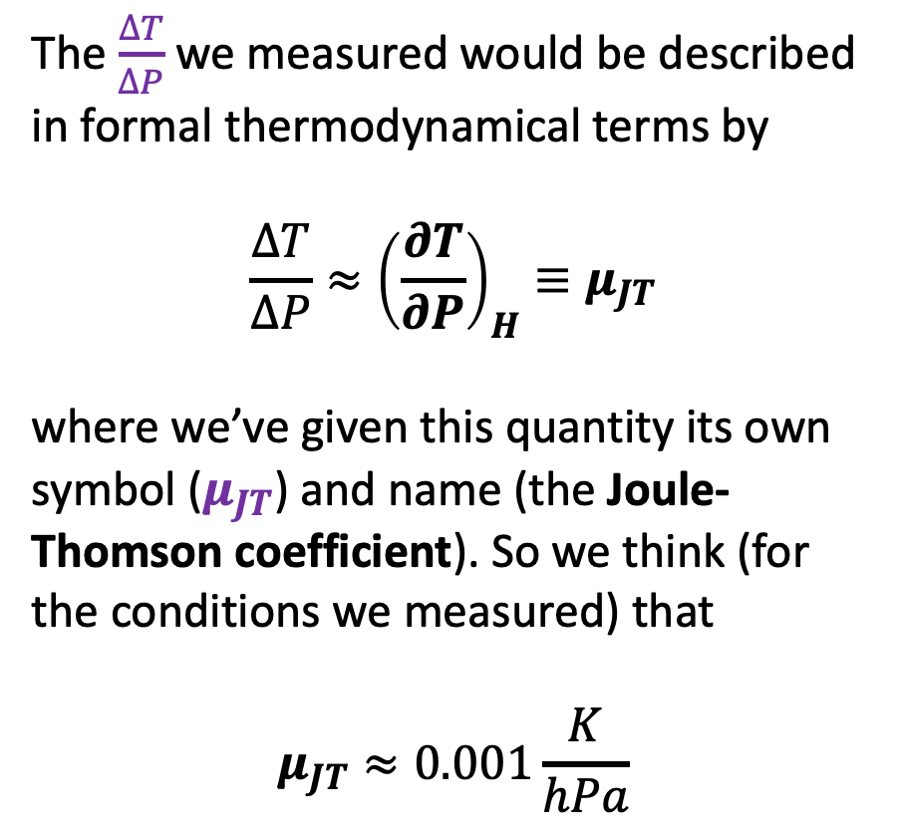

How $\frac{∆T}{∆P}$ appears in a thermodynamic surface
The $\frac{∆T}{∆P}$ we measured would be described in formal thermodynamical terms by
$$\frac{∆T}{∆P}≈{\left(\frac{∂T}{∂P}\right)}_{H}≡μ_{JT}$$
where we’ve given this quantity its own symbol ($μ_{JT}$) and name (the Joule-Thomson coefficient). So we think (for the conditions we measured) that
$$μ_{JT}≈0.001\frac{K}{hPa}$$
$$μ_{JT}$$

Slide 2
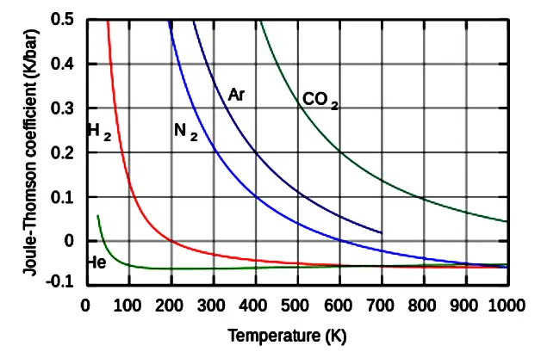
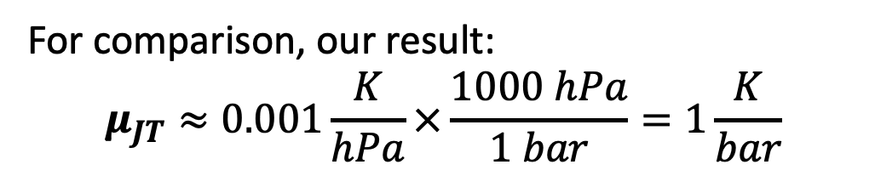
Literature values for $μ_{JT}$
https://cdn.instrumentationtools.com/wp-content/uploads/2019/01/Joule%E2%80%93Thomson-effect.png
For comparison, our result:
$$μ_{JT}≈0.001\frac{K}{hPa}×\frac{1000 hPa}{1 bar}=1\frac{K}{bar}$$

Slide 3

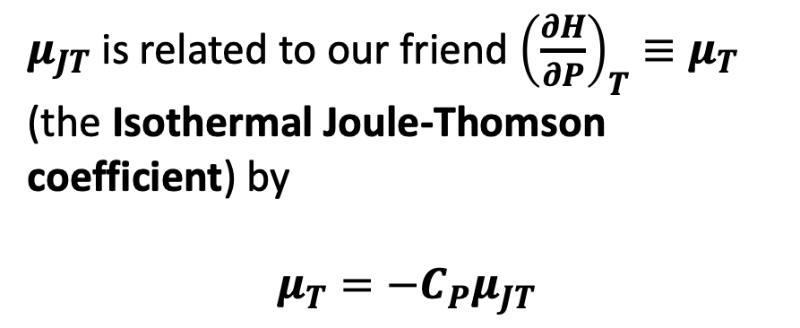
Using $μ_{JT}$to find $μ_{T}$
$$μ_{T}$$
$μ_{JT}$ is related to our friend ${{\left(\frac{∂H}{∂P}\right)}_{T}≡μ}_{T}$ (the Isothermal Joule-Thomson coefficient) by
$$μ_{T}=−C_{P}μ_{JT}$$
$$μ_{JT}$$

Slide 4
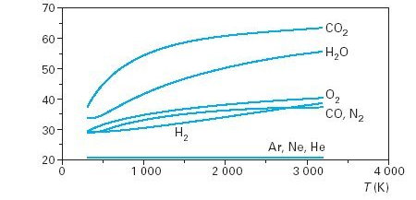
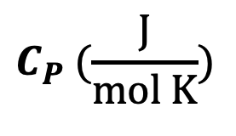
Literature values for $C_{P}$
$$C_{P} (\frac{J}{mol K})$$
https://i.stack.imgur.com/9GRM4.jpg

Slide 5
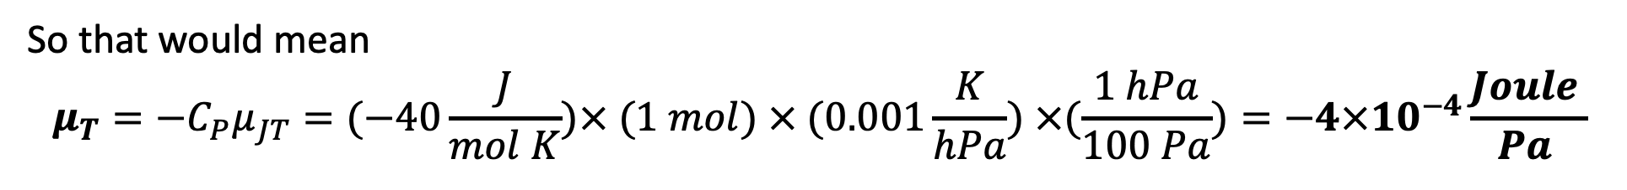
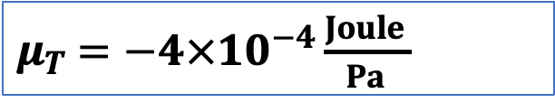

Using $μ_{JT}$to find $μ_{T}$
$μ_{T}$ $=−4×10^{−4}\frac{Joule }{Pa }$
$μ_{JT}$ is related to our friend ${{\left(\frac{∂H}{∂P}\right)}_{T}≡μ}_{T}$ (the Isothermal Joule-Thomson coefficient) by
$$μ_{T}=−C_{P}μ_{JT}$$
$$μ_{JT}$$
So that would mean
$$μ_{T}=−C_{P}μ_{JT}=(−40\frac{J}{mol K})× (1 mol) × (0.001\frac{K}{hPa}) ×(\frac{1 hPa}{100 Pa})=−4×10^{−4}\frac{Joule }{Pa }$$

